Slide 1
2B - Beyond Social: A Complete Strategy for Marketing Your SMM Business
Presenters: Anna Novak, Simply Downsized, Falls Church, Va; Jaymie Shook, Wheaton Bekins, Indianapolis, IN
Friday, September 27, 2024 • 2:15 pm - 3:15 pm

Slide 2
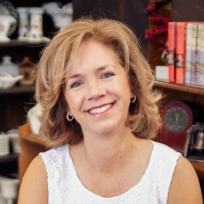
PRESENTED BY
Jaymie Shook Wheaton | Bekins Marketing Executive with tons of experience in the corporate world and smaller operators too.
Anna Novak HomeTransitionPros.com Content Creator in the downsizing and senior move niche, manages a national directory of
Senior Move Specialists

Slide 3
SESSION LEARNING OBJECTIVES
After this session, participants will be able to:
Create or revisit marketing goals.
Define messaging for ideal clients.
Leverage local business environments.
List proven marketing methods and platforms.
Create a plan to evaluate and adjust their marketing strategy.

Slide 4
Is It Time to Revisit Your Marketing Strategy?
Questions to Consider:
How are you handling your marketing?
Do you have a written marketing strategy?

Slide 5
Common Objections to Marketing Investment
"Word of mouth works for us."
"We have plenty of work and don’t want more."
"Seniors aren’t on social media."
"It’s too hard to keep up with Google, AI, and big spenders."

Slide 6
PROVEN METHODS: MARKETING MIX
STRATEGY
SUPPORTING COLLATERAL
BRAND
BUSINESS COMMUNITY
MESSAGING
ONLINE PRESENCE

Slide 7
STRATEGY
Set a budget
Identify your ideal customer
Set measurable goals
Position your business
Track site traffic and leads

Slide 8
STRATEGY
Revisit your budget: realistic expectations.
Define and measure your spending.
Evaluate your energy expenditure.

Slide 9
Identifying Your Ideal Customer
Baseline Strategy:
Know your primary customer
Understand their needs and pain points
Expand to Include:
Referral partners
B2B pain points and solutions
Brainstorm additional ideal customers

Slide 10
BRAND
Use consistent logo, colors, style.
Define company tone.
Ensure brand consistency.

Slide 11
BRAND
Align brand with business strategy.
Differentiate in the marketplace.
Communicate brand to B2B partners.

Slide 12
MESSAGING
Focus on pain points.
Explain benefits, not just features.
Tell your business story.

Slide 13
MESSAGING
Revisit and tweak messaging.
Tailor to different audiences.
Use various formats, including video.

Slide 14
SUPPORTING COLLATERAL
Define collateral (handouts, business cards, digital).
Inventory your current collateral.
Balance digital and physical collateral.

Slide 15
SUPPORTING COLLATERAL
Align marketing and sales collateral.
Consider going digital.
Explore direct mail options.

Slide 16
BUSINESS COMMUNITY
Baseline Strategy:
Build relationships.
Maintain referral partner list.
Stay in touch with partners.

Slide 17
BUSINESS COMMUNITY
Identify best referral sources.
Engage with local business environment.
Show leadership in your local network.

Slide 18
ONLINE PRESENCE
Keep website current.
Maintain social media presence.
Send monthly newsletters.

Slide 19
ONLINE PRESENCE
Define your goals and CTA.
Assess where you show up online.
Optimize for engagement.

Slide 20
Proven Platforms: Social Media
Baseline Strategy:
Facebook/Instagram
Regular posting
Relevant content
Advanced Efforts:
Focus on brand storytelling.
LinkedIn for B2B networking.
Use video for content.

Slide 21
Newsletters and Email Marketing
Baseline Strategy:
Send quarterly emails.
Maintain your email list.
Advanced Efforts:
Monthly designed newsletters.
Build and expand your email list.

Slide 22
Evaluate and Adjust
Track KPIs and ROI.
Use a simple spreadsheet to list and track initiatives.
Regularly assess and adjust your strategy.

Slide 23
CONCLUSION
Key Takeaways:
Plan and budget for multi-faceted marketing.
Align marketing with business goals.
Manage your online presence.
Leverage local business environment.
Regularly evaluate and adjust.

Slide 24
FINAL THOUGHTS
Recognize when to outsource.
Utilize diverse skill sets within your team.
Stick to the plan and own your strategy.

Slide 25
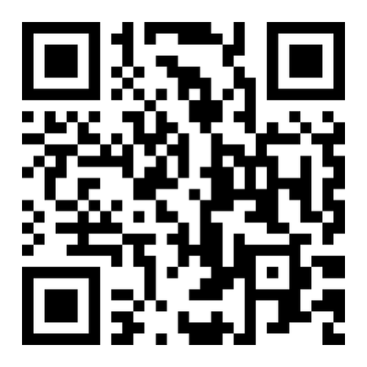
BONUS
Sample Marketing Plan
Sample/model marketing calendar.
Discuss how to implement and track marketing initiatives.

Slide 26
THANK YOU
Contact Information:
Jaymie: Jaymie_Shook@WVLCorp.com
Anna: Anna@HomeTransitionPros.com
Questions?**

