Slide 1
8H • Marketing to Boomer Women: In Charge and On The Move
Anna Novak
Sunday, November 12th • 9:45 am

Slide 2
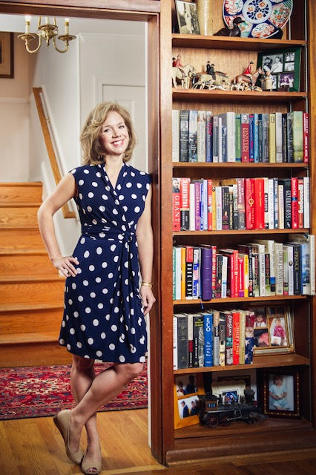
About Anna
Anna Novak
Downsizing Specialist
Content Creator
Anna@HomeTransitionPros.com
703-402-0471 Cell

Slide 3
Marketing to Boomer Women
Know your audience
Know their pain points
Offer solutions
Show how they will benefit

Slide 4
Your Boomer Audience …. Demographics
Primarily female
Age 55 and up (usually 65 - 77)
Many are single due to divorce or death of spouse
College educated
Middle to upper-class

Slide 5
Your Boomer Audience …. Psychographics
Values
Interests
Challenges
Goals

Slide 6
Your Boomer Audience …. Values
Family
Health
Wellness
Comfort

Slide 7
Your Boomer Audience …. Interests
Travel
Hobbies
Spending time with children / grandchildren

Slide 8
Your Boomer Audience …. Challenges
Emotional attachment to belongings
Concerns about aging-in-place vs transitioning to a retirement community

Slide 9
Your Boomer Audience …. Goals
Simplifying life
Maintaining an active lifestyle
Ensuring financial security

Slide 10
Your Boomer Audience …. Buying Behavior
Avid researchers
Most loyal of all shoppers
Brand loyalty
Seeks live customer service instead of tech support
Prefers in-person interaction within their community

Slide 11
Your Boomer Audience …. Buying Behavior
Don't mind spending money where there is value
Willing to invest in services
Want peace-of-mind and a stress-free transition

Slide 12
Boomers as Downsizers …. Pain Points
Should I age-in-place or retrofit my house?
Will I be able to find a new home I can afford?
Will I still be able to help family members?
How will I accomplish the downsizing process?
How can I let go of my possessions?

Slide 13
Meeting Your Boomer Where She Is
Remember:
She is brand loyal
She is a researcher
So how will you build a message that resonates with her and suits her preferences?

Slide 14
Understanding Brand
Your brand should:
Build a relationship with the Boomer community
Have a tone of voice that is relatable
Help their target audience feel they have found the right brand for their needs
Use a logo, color scheme, and fonts to craft the right message for your audience

Slide 15
Understanding Brand
YOU ARE A BRAND! Your brand MUST align with Baby Boomers' values and aspirations that are showcased as:
Caring
Trustworthy
Dependable
Experienced

Slide 16
Your Story …. Their Language
If you know Boomers, you know there is always a story to tell! And you have a story to tell, too! Your experience, resourcefulness, and understanding of the ins and outs of downsizing are essential.

Slide 17
Your Story …. Their Language
Do:
Build a relationship with your Boomers with messaging that speaks to them
Be clear
Be respectful
Be understanding
Be sensitive to the Boomers' sense of nostalgia
Don’t:
Focus on yourself and your experience
Use slang or industry jargon

Slide 18
Be the Solution / Be Relatable
Put yourself in the position of your Boomer and consider:
What is essential to your Boomer audience?
Why should she seek your business for help?
Why should she trust you?
How do you want her to feel about your business?
Are you talking to your Boomers like you would talk to your grandmother, or best friend's aging mother?
Be relatable!

Slide 19
Website Dos
Typography: Clear and readable
Navigation: Simple menu (5 options or less), always visible
CTAs and Links: Bold, easy to recognize
Colors and Images: Avoid distraction, high contrast
About Page: Introduce yourself. Be relatable. Show your team. Include lots of images.
Content: Bite-sized pieces
Make it mobile-friendly!

Slide 20
Website Don’ts
Feature images that represent aging
Hide contact information
Feature unnecessary video or sounds
Immediately ask for information
Have an unsecure website
Overuse popups or canned chat
Ask for age or address

Slide 21
Capturing Email Address
Savvy Boomers will easily get annoyed if you overuse their email address
Offer sincere value
Experiment with a “less is more” approach
Trust and transparency first

Slide 22
Boomer-Friendly Email Opt-In Ideas
Free ‘How-To’ Guides or e-book to download.
Offer a Family / Grandparent resource
Offer free ‘Health and Wellness’ tips via email
Consider offering a ‘Home Downsizing Quiz’ to help assess their readiness for downsizing

Slide 23
Social Media – Let's Go Facebook
Facebook is the #1 place your Boomer will look to get more information about your business.
How to Make Facebook work for your business:
Post consistently
Post relevant info
Add behind-the-scenes details
Use humor (appropriately)

Slide 24
Advertising Options
Facebook Ads
Targeted Google Ads
YouTube
Print

Slide 25
Consider Meet and Greets
Boomers LOVE in-person interactions!
Host a live ‘Meet and Greet’
Partner with a local Retirement Attorney for an Estate Planning Clinic
Offer a ‘Walking Down Memory Lane’ Workshop
Partner with a ‘Wine and Design’ for a Boomer Art Class
Others?

Slide 26
Marketing to Boomer Women
Summary
Know your audience
Know their pain points
Offer solutions
Show how they will benefit

Slide 27
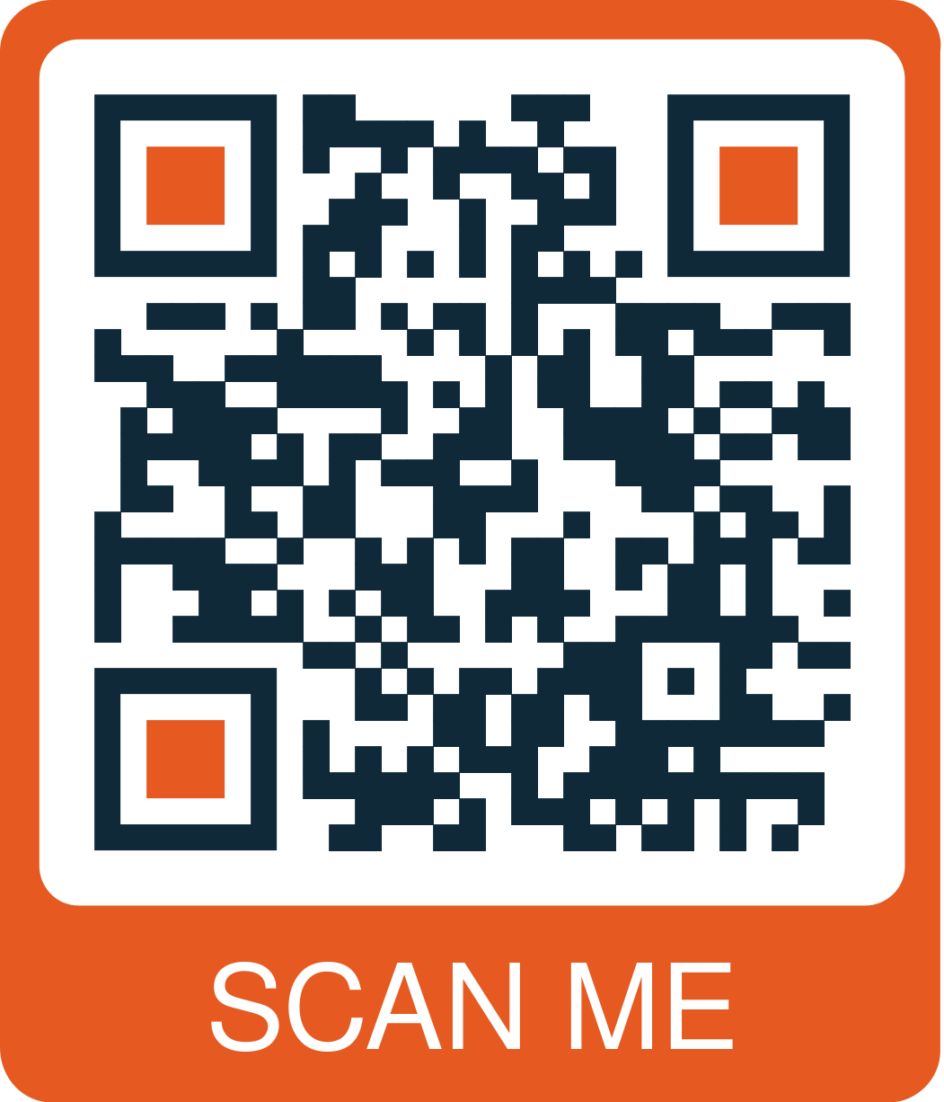
Questions and Takeaways
Scan the QR code for a conference follow up and freebies!
Anna Novak
Anna@HomeTransitionPros.com
703-402-0471 Cell

